Slide 1
NorthSTAR User Training
Module 2
Issue Bond
Internal User

Slide 2
NorthSTAR Bond Issuance Functions
Purpose: To orient the user to the bond issuance function in NorthSTAR.
Common icons and text colors in this presentation:
Blue text in NorthSTAR means the text is a hyperlink to another form or data table.
An icon like this: denotes a point of interest or an important feature in NorthSTAR. It will usually be accompanied with an arrow like this and descriptive text. The number will be cross referenced to information in the training outline.
Black text or greyed out arrows or features cannot be used in the current context.
A black box with green text at the bottom left of the slide ( ) shows the training module and slide number. This is cross referenced to the Training outline used in conjunction with this presentation.
1
Mod 1 Slide 2.10

Slide 3
NorthSTAR Log-In Page
Mod 2 Slide 2.1

Slide 4
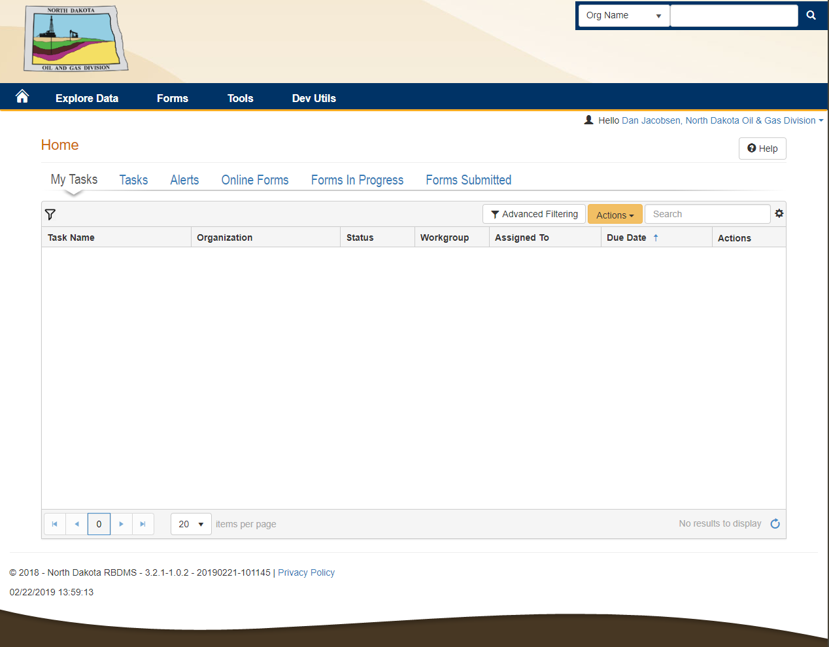
NorthSTAR Home Page for Internal User
Mod 2 Slide 2.2

Slide 5
NorthSTAR Online Forms
1
Click online forms
3
2
Online form choices appears
Mod 2 Slide 2.3

Slide 6
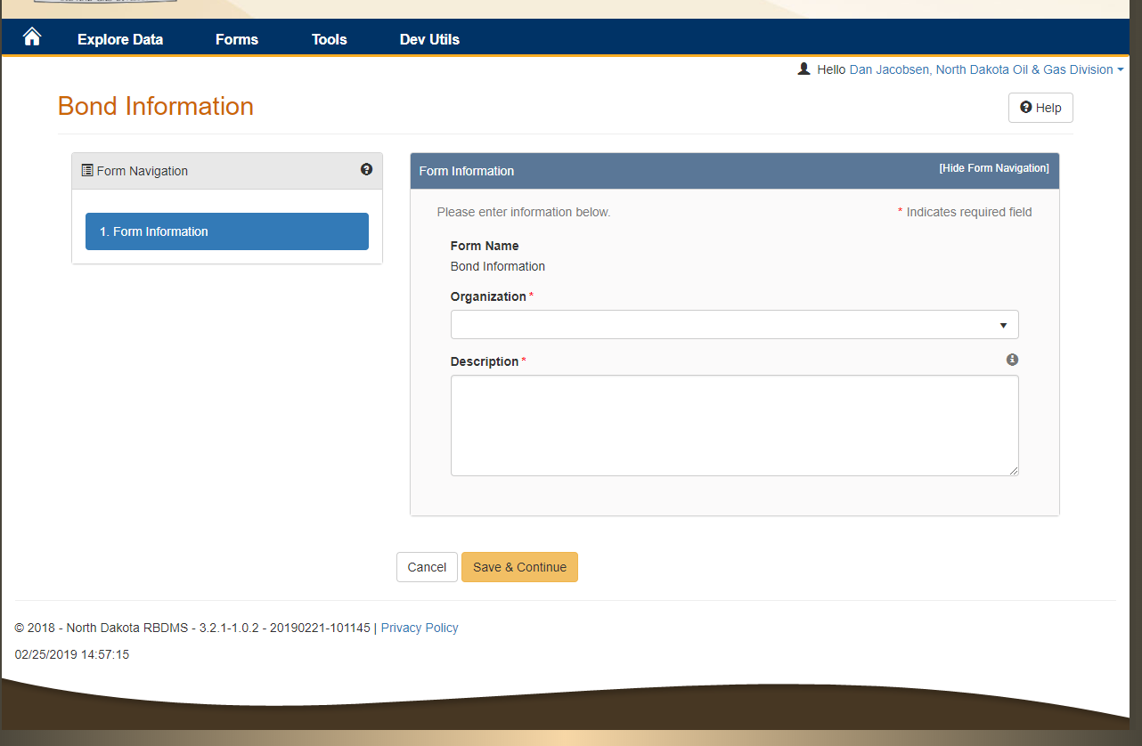
NorthSTAR Bond Information Page
1
Organization is selected
2
Description is entered
3
Clicked
Mod 2 Slide 2.4

Slide 7
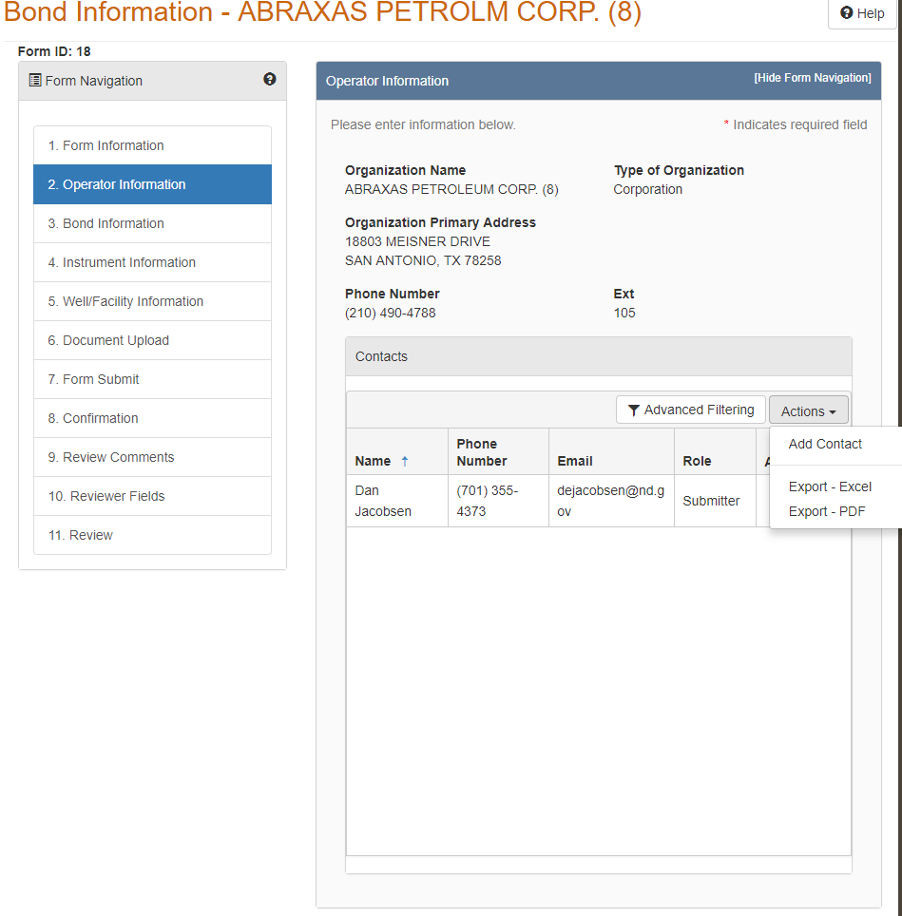
NorthSTAR Operator Information Page
1
Operator Information Page
3
Select
2
Information form
Mod 2 Slide 2.5

Slide 8
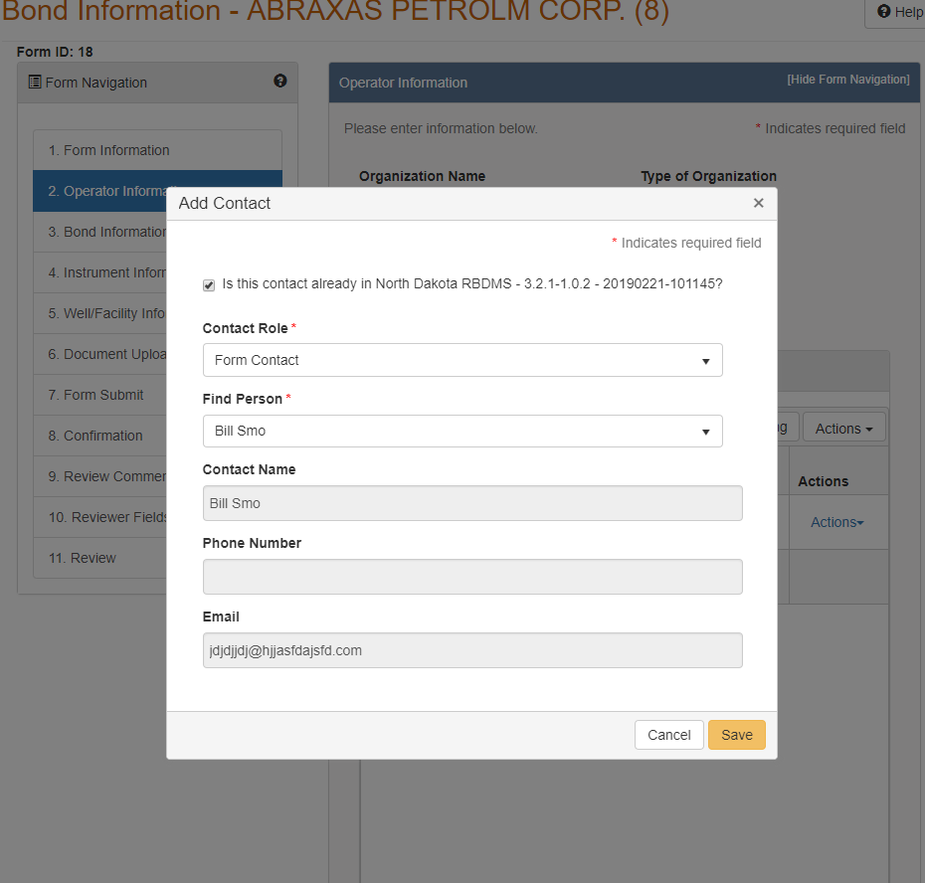
NorthSTAR add new contact window
1
Add contact form
2
Save new contact
Mod 2 Slide 2.6

Slide 9
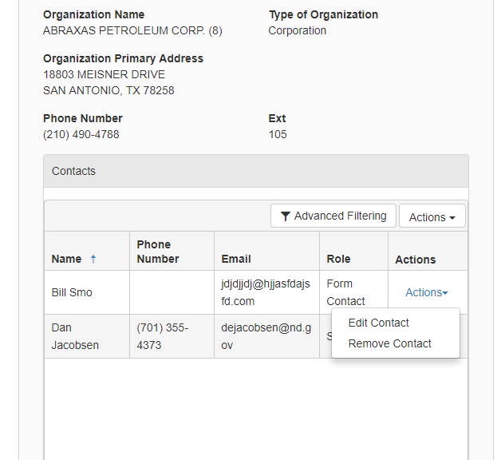
NorthSTAR Contact Actions Window
1
New contact is added
2
Contact Actions
Mod 2 Slide 2.7

Slide 10
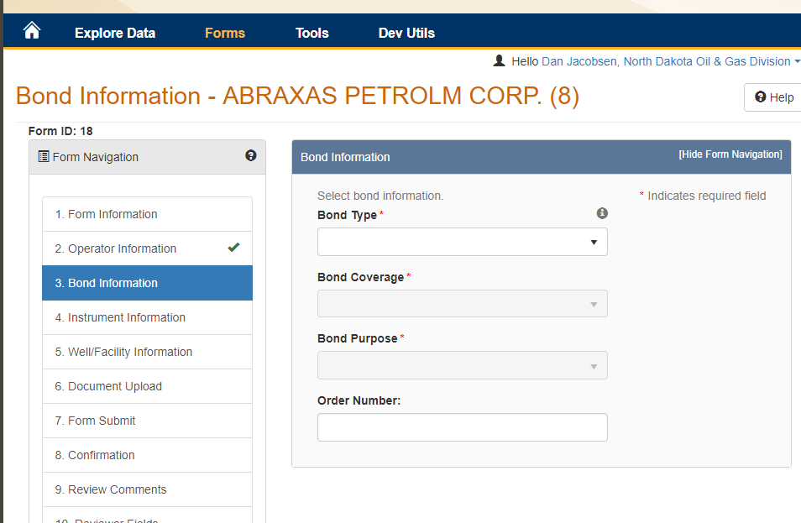
NorthSTAR Bond Information Screen
2
Bond information window
1
Bond Information Window is Opened when clicked
Mod 2 Slide 2.8

Slide 11
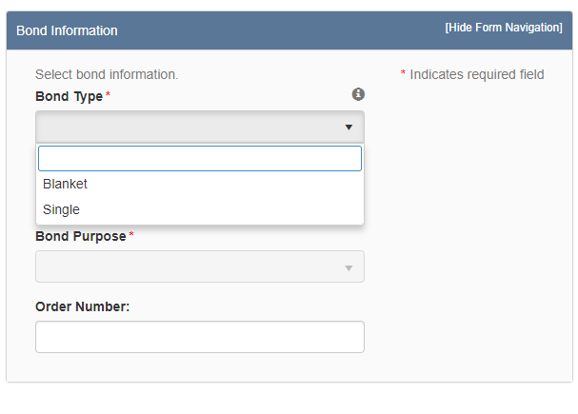
NorthSTAR Bond Information Window
1
Bond Information Window
2
Bond type drop down
3
Select
Mod 2 Slide 2.9

Slide 12
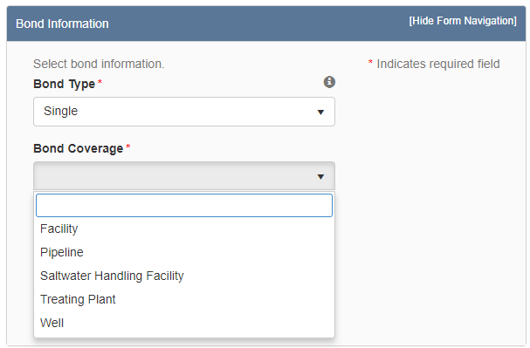
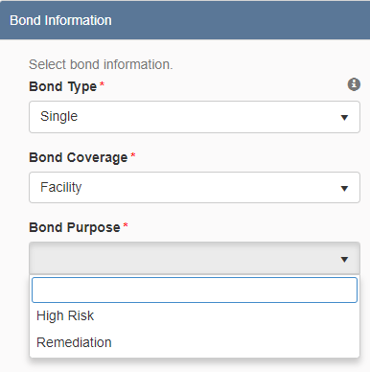
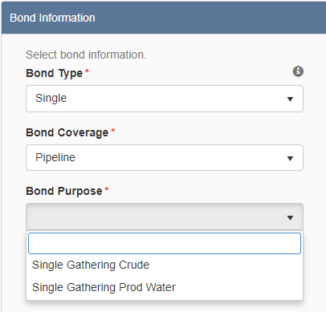
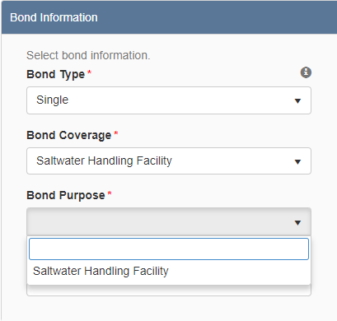
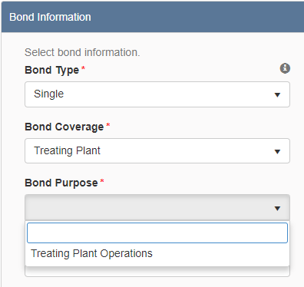
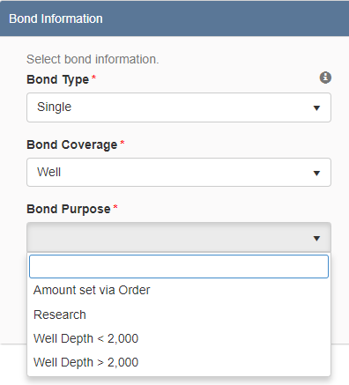
NorthSTAR Bond Purpose Selection Options – Single Bond Type
3
Bond Purpose Results Dependent on Bond Type Selection
1
Bond type selection: Single
Selections available in bond coverage drop down if single is chosen as bond type
2
Mod 2 Slide 2.10

Slide 13
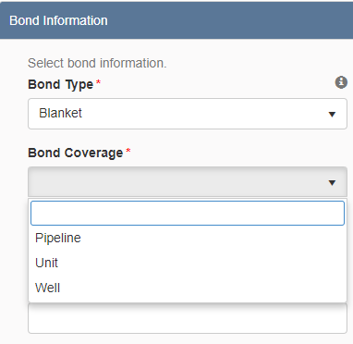
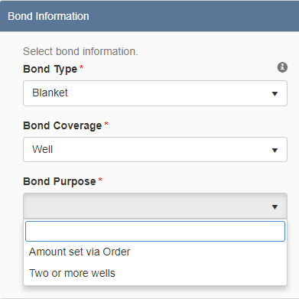
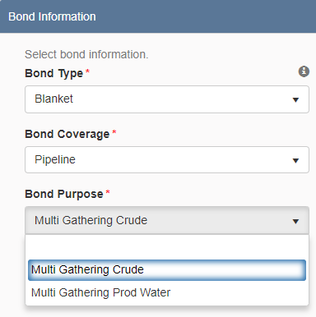
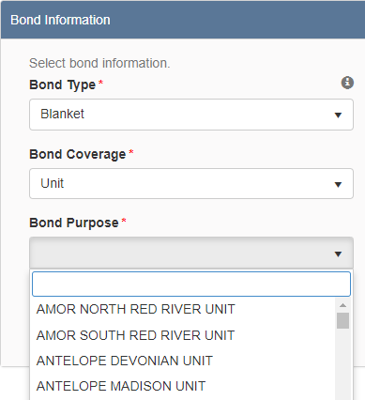
NorthSTAR Bond Purpose Selection Options – Blanket Bond Type
1
Bond type selection: Blanket
3
Bond Purpose Results Dependent on Bond Type Selection
Selections available in bond coverage drop down if blanket is chosen as bond type
2
Mod 2 Slide 2.11

Slide 14
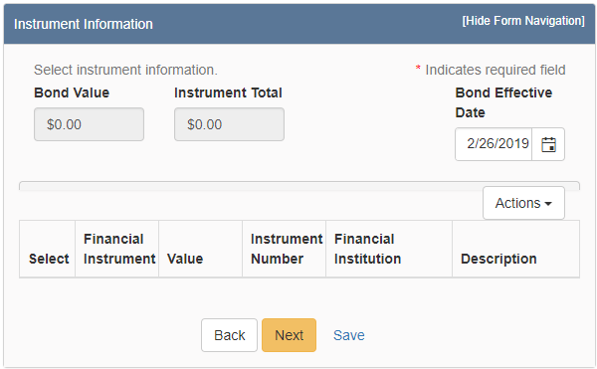
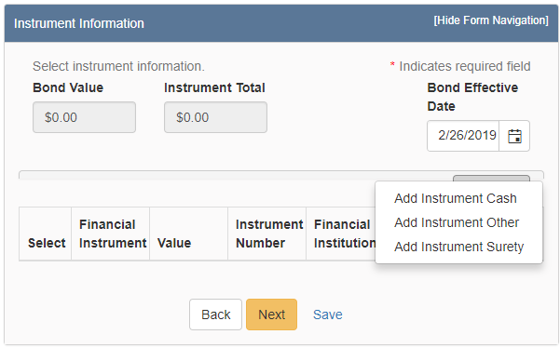
NorthSTAR Instrument Information Screen
1
Click actions to add instrument
Mod 2 Slide 2.12

Slide 15
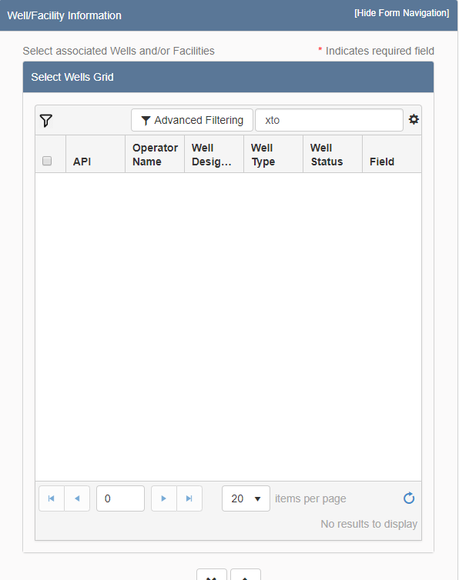
NorthSTAR Well/Facility Information Screen
Mod 2 Slide 2.13

Slide 16
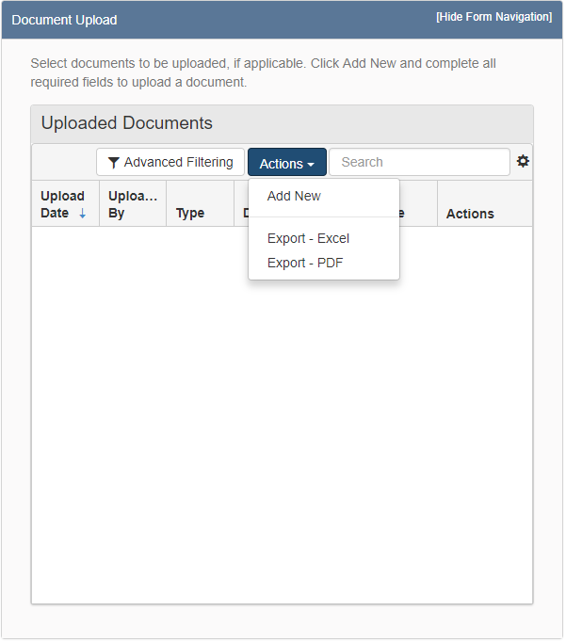
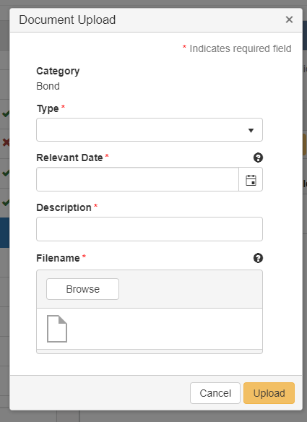
NorthSTAR Upload Document Screen
1
Click actions to select new document to upload
Mod 2 Slide 2.14

Slide 17
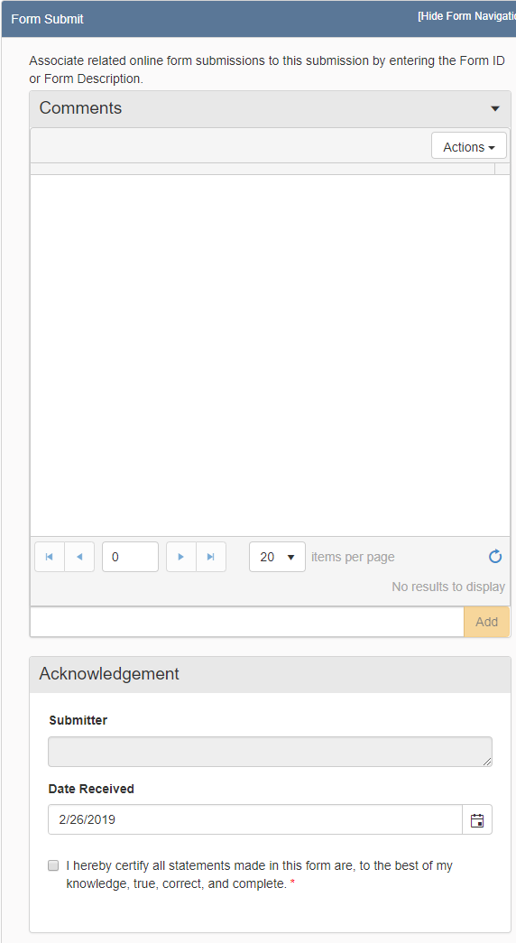
NorthSTAR Form Acknowledgement
1
Check box to acknowledge authorization to submit form
Mod 2 Slide 2.15

Slide 18
NorthSTAR Form Submission Confirmation
Mod 2 Slide 2.16

Slide 19
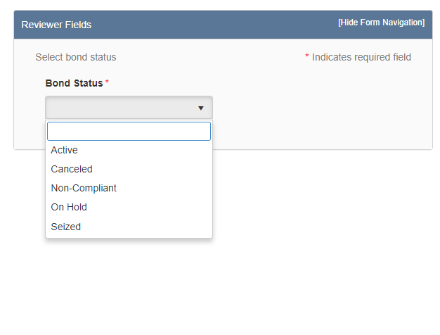
NorthSTAR Form Review
Mod 2 Slide 2.17
Mod 2 Slide 2.17

Slide 20
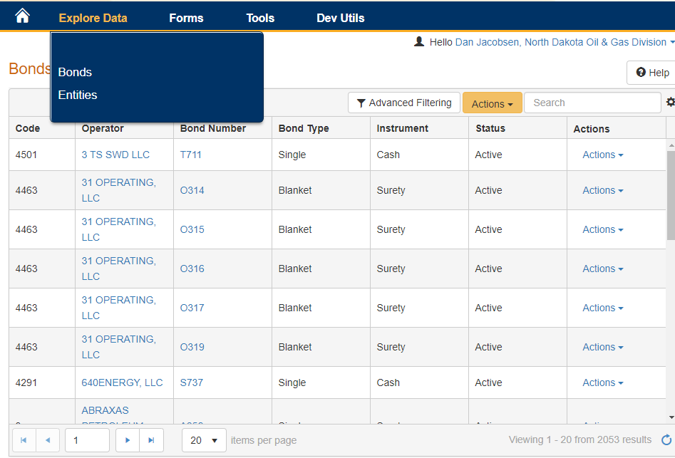
NorthSTAR Select bond for review
1
Explore data, bonds
2
List of Bonds is displayed
3
Select bond number to open bond detail
Mod 2 Slide 2.18

Slide 21
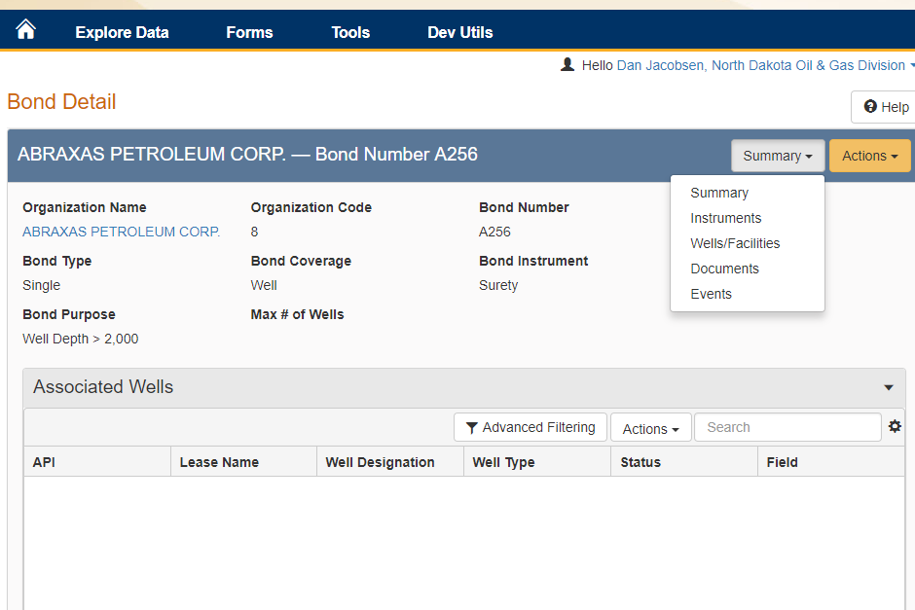
NorthSTAR Review Bond Detail
Mod 2 Slide 2.18

